Slide 1
Present continuous

Slide 2

Observe as seguintes frases:
Eu estou trabalhando. Te ligo depois.
Ela está estudando inglês.
Nós estamos indo para praia semana
que vem.

Slide 3
PRESENT CONTINUOUS:
I am working. I call you later.
She is studying English.
We are going to the beach next week.
KEY-WORDS: NOW, RIGHT NOW, AT THE MOMENT, TODAY, TONIGHT

Slide 4
PRESENT CONTINUOUS:
I am working. I call you later.
(doing at the moment)
She is studying English.
(doing at the moment)
We are going to the beach next week.
(a future plan)

Slide 5
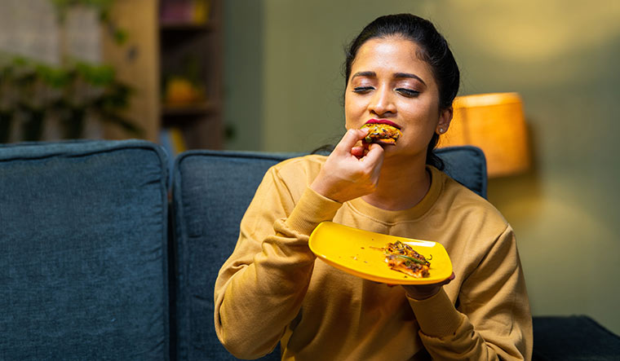
FOR EXAMPLE:
What is she doing?

Slide 6
FOR EXAMPLE:
What is she doing?
She is eating!

Slide 7
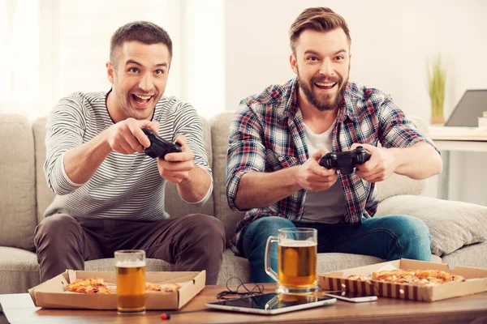
FOR EXAMPLE:
What are they doing?

Slide 8
FOR EXAMPLE:
What are they doing?
They are playing video games!

Slide 9
FOR EXAMPLE:
What are you doing?

Slide 10

FOR EXAMPLE:
Exactly! You are studying!

Slide 11

Present continuous form:
Affirmative
I am working
She is working
He is working
It is working
We are working
You are working
They are working
-ING

Slide 12

Present continuous form:
Negative
I am not working
She is not working
He is not working
It is not working
We are not working
You are not working
They are not working

Slide 13

Present continuous form:
Question
Am I working?
Is she working?
Is he working?
Is it working?
Are we working?
Are you working?
Are they working?

Slide 14
(what) is she doing?
(what) are they doing
(what) are you doing?
(where) are you going?
(where) is he going?
(where) is she going?

